Slide 1

BASIS DATA - TI14KB21
Meeting 3
Entity Relational Model and Diagram ( ERM&ERD )
Bagus Kristomoyo Kristanto S.Kom , M.MT
bagus.kristanto@stiki.ac.id

Slide 2
Outline
01
Entity Relational Model
Basic relational Database based on entity relational
02
Notation Entity Relational Model
Drawing notation on Entity Relational Model
03
Weak Entities, Attribute, and Relationship
Learn about how to creating a ERM and ERD
04
Practice
.

Slide 3
1976 proposed by Peter Chen
ER diagram is widely used in database design
Represent conceptual level of a database system
Describe things and their relationships in high level
Entity-Relationship Data Model (ERM) is a detailed, logic-al representation of the data for an organization or for a bu-siness area.
Expressed in terms of:
Entities
Attributes
Relationships
Entity-Relationship Diagram (ERD) is a graphical representation of a Entity-Relationship Model.
Entity Relational

Slide 4
Entity: Real-world object distinguishable from other objects. An entity is described (in DB) using a set of attributes.
Entity Set: A collection of similar entities. E.g., all employees.
All entities in an entity set have the same set of attributes. (Until we consider ISA hierarchies, anyway!)
Each entity set has a key.
Each attribute has a domain.
ERM Basic
name
ssn
age
Employees

Slide 5
Key and key attributes:
Key: a unique value for an entity
Key attributes: a group of one or more attributes that uniquely identify an entity in the entity set
Super key, candidate key, and primary key
Super key: a set of attributes that allows to identify and entity uniquely in the entity set
Candidate key: minimal super key
There can be many candidate keys
Primary key: a candidate key chosen by the designer
Denoted by underlining in ER attributes
ERM Basic
name
ssn
age
Employees

Slide 6
ERM Basic
Relationship: Association among two or more entities.
e.g., Jack works in Pharmacy department.
Relationship Set: Collection of similar relationships.
An n-ary relationship set R relates n entity sets E1 ... En;
each relationship in R involves entities e1 in E1, ..., en in En
Same entity set could participate in different relationship sets, or in different “roles” in same set.
name
since
ssn
age
name
dname
ssn
age
did
budget
Employees
super-visor
subor-dinate
Employees
Works_In
Departments
Reports_To

Slide 7
ERM Basic
Consider Works_In:
An employee can work in many departments;
a dept can have many employees.
In contrast,
each dept has at most one manager, according to the key constraint on Manages.
1-to-1
1-to Many
Many-to-1
Many-to-Many
since
name
dname
ssn
lot
did
budget
Employees
Manages
Departments

Slide 8
Unary Relationship
Relationship between the instances of one entity type
Is_married_to Manages
One-to-one One-to-many
EMPLOYEE
PERSON

Slide 9
Binary Relationship
Relationship between the instances of two entity type.
Is_assigned Contains
One-to-One One-to-Many
Can also have many to many!
EMPLOYEE
PARKING
SPACE
PRODUCT
LINE
PRODUCTS

Slide 10
Ternary Relationship
A simultaneous relationship among instances of three entity types.
Supplies
PART
VENDOR
WAREHOUSE

Slide 11
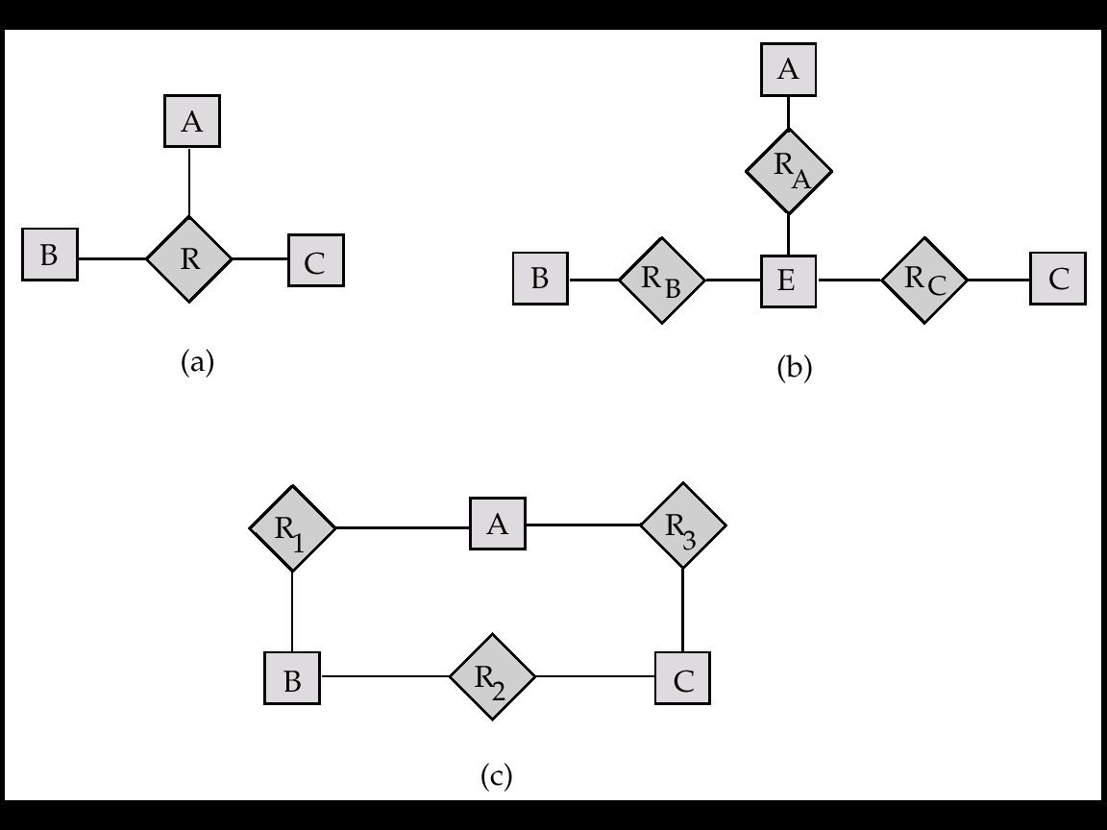
Converting Ternary to binary

Slide 12
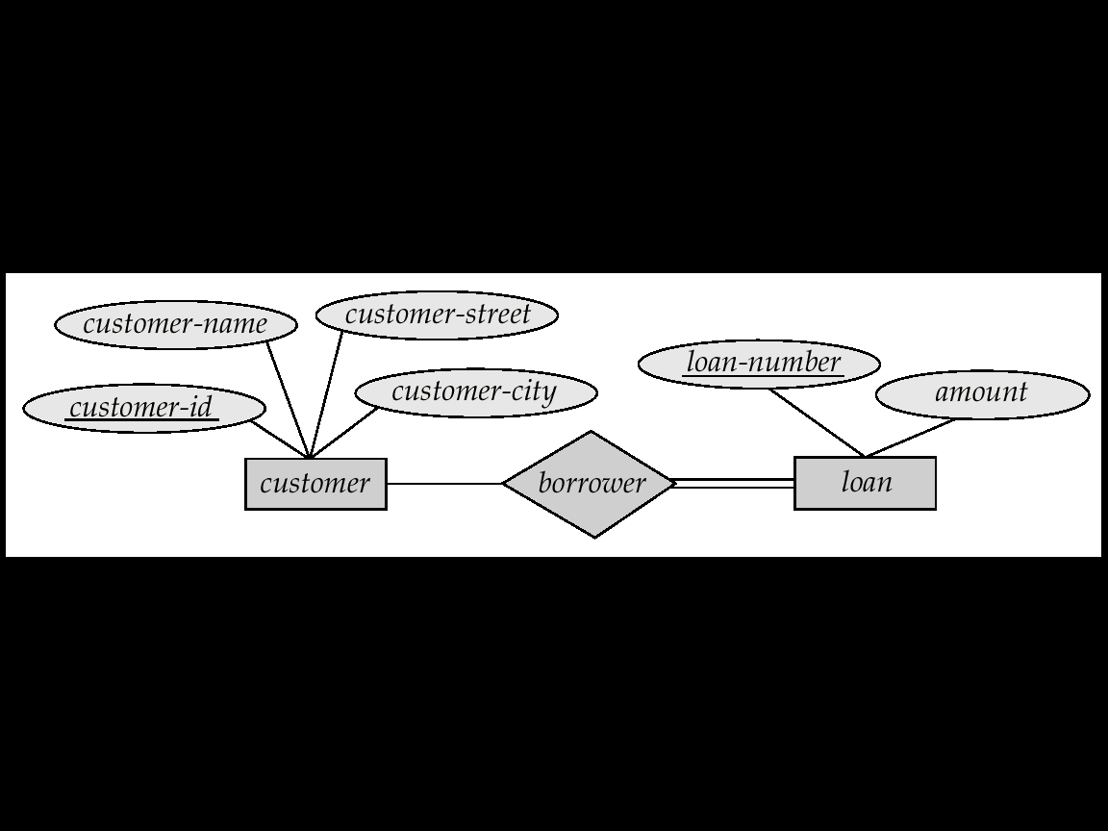
Total Participant
Does every department have a manager?
If so, this is a participation constraint: the participation of Departments in
Manages is said to be total (vs. partial).
Completeness constraint (use double lines)
Total : an entity must belong to one of the lower-level entity sets
Partial: an entity need not belong to one of the lower-level entity sets
.

Slide 13
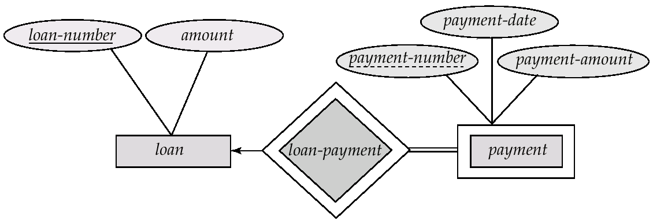
Weak Entities
A weak entity can be identified uniquely only by considering the primary key of another (owner) entity.
Owner entity set and weak entity set must participate in a one-to-many relationship set (one owner, many weak entities).
Weak entity set must have total participation in this identifying relationship set.
Double rectangles for
weak entity set
Double diamond for
weak entity relationship
Dashed underscore for
discriminator

Slide 14
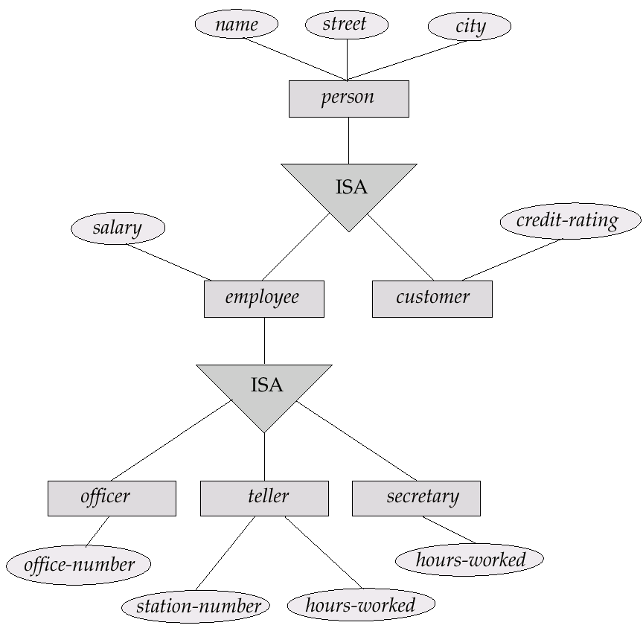
Specialization
A lower-level entity set inherits all the attributes and relationship participation of the higher-level entity
set to which it is linked.
A lower-level entity set may have additional attributes and participate in additional relationships

Slide 15
Aggregation
name
ssn
lot
Used when we have to model a relationship involving (entity sets and) a relationship set Aggregation allows us to treat a relationship set as an entity set for purposes of participation in (other) relationships.
Employees
Monitors
until
since
Aggregation vs. ternary relationship:
Monitors is a distinct relationship,
with a descriptive attribute.
Also, can say that each sponsorship
is monitored by at most one employee
started_on
dname
pid
pbudget
did
budget
Projects
Sponsors
Departments

Slide 16
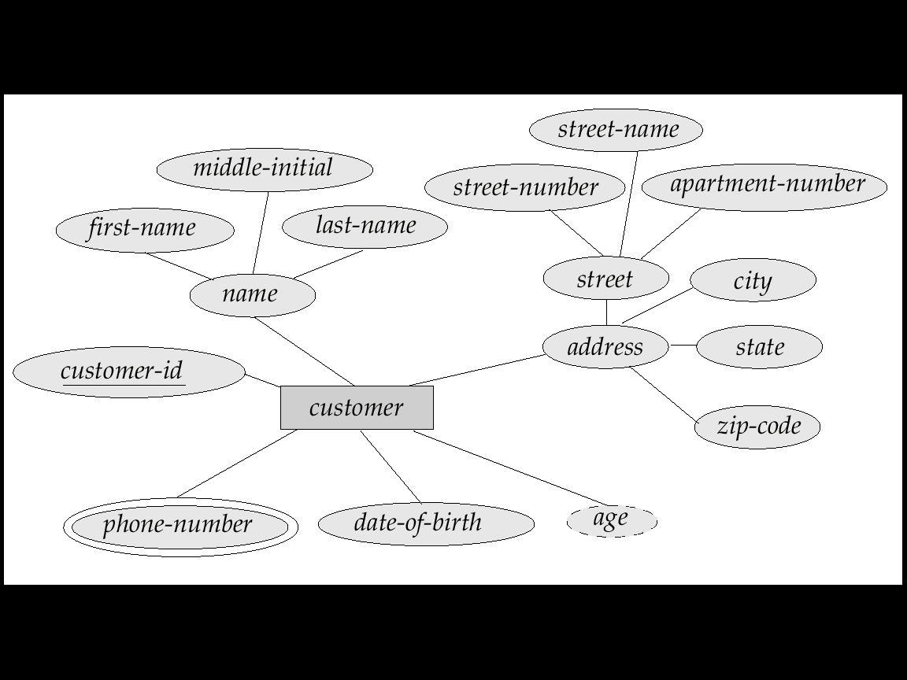
Attributes
Both entity sets and relationships can have attributes
Attributes may be
Composite - attributes that are still have a sub attribute
Multi-valued (double ellipse) - the value of an attribute that has more than one (multi value) value of the attribute in question
Ex. Each Car can have multiple (multivalued) "colors (white, red, etc.")
Derive (dashed ellipse) - attribute that does not have to be stored in database.

Slide 17
Keys
A super key of an entity set is a set of one or more attributes whose values uniquely determine each entity.
A candidate key of an entity set is a minimal super key
Although several candidate keys may exist, one of the candidate keys is selected to be the primary key.
Suggest super keys for the following entity?
What are the candidate keys?
Primary key?
author
name
death
birthday
description

Slide 18
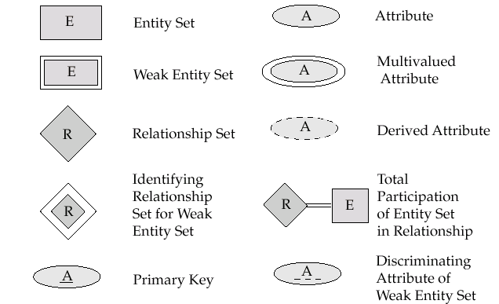
Notation

Slide 19

Notation

Slide 20
Entity vs. Attribute
Should address be an attribute of Employees or an entity
(connected to Employees by a relationship)?
Depends upon the use we want to make of address information, and the semantics of the data:
If we have several addresses per employee, address must be an entity (since attributes cannot be set-valued).
If the structure (city, street, etc.) is important, e.g., we want to retrieve employees in a given city, address must be modeled as an entity (since attribute values are atomic).

Slide 21
Entity vs. Attribute
from
to
name
dname
ssn
lot
did
budget
Employees
Works_In4
Departments
Works_In4 does not allow an employee to work in a department for two or more periods.
Similar to the problem of wanting to record several addresses for an employee: We want to record several values of the descriptive attributes for each instance of this relationship. Accomplished by introducing new entity set, Duration.
name
dname
ssn
lot
did
budget
Employees
Works_In4
Departments
from
Duration
to

Slide 22
Entity vs. Relationship
since
dbudget
name
dname
ssn
lot
did
budget
Employees
Manages2
Departments
First ER diagram OK if a manager gets a separate discretionary budget for each dept
What if a manager gets a discretionary budget that covers all managed depts?
Redundancy:
dbudget stored for each dept managed by manager.
Misleading:
Suggests dbudget associated with department-mgr combination.
name
ssn
lot
since
dname
Employees
did
budget
Manages2
Departments
ISA
Managers
dbudget

Slide 23
Binary vs. Ternary Relationships
name
ssn
age
pname
age
Employees
Covers
Dependents
Bad design
Policies
If each policy is owned by just 1 employee, and each dependent istied to the covering policy, first diagram is inaccurate.
What are the additional constraints in the 2nd diagram?
policyid
cost
name
pname
age
ssn
lot
Dependents
Employees
Purchaser
Beneficiary
Better design
Policies
policyid
cost

Slide 24
Binary vs. Ternary Relationships
name
ssn
age
pname
age
Employees
Covers
Dependents
Bad design
Policies
If each policy is owned by just 1 employee, and each dependent istied to the covering policy, first diagram is inaccurate.
What are the additional constraints in the 2nd diagram?
policyid
cost
name
pname
age
ssn
lot
Dependents
Employees
Purchaser
Beneficiary
Better design
Policies
policyid
cost

Slide 25
Exercise Time
Individual Exercise

Slide 26
Exercise ERD
Design an ER diagram for an online music store. The database will contain at least the following concepts: songs, artists, bands, albums, and genres.
State your design assumptions you make to support design decisions. Be sure your assumptions are reasonable.

Slide 27
Thank you

